Slide 1
Design and Analysis of Algorithms
Dynamic Programming
National University of Computer and Emerging Sciences, Islamabad

Slide 2
Divide and Conquer
It deals (involves) three steps at each level of recursion:
Divide the problem into a number of subproblems
Conquer the subproblems by solving them recursively
Combine the solution to the subproblems into the solution for original subproblems.
MergeSort, Quick Sort, Binary Search

Slide 3
Recursive Definition of the Fibonacci Numbers
The Fibonacci numbers are a series of numbers as follows:
fib(1) = 1
fib(2) = 1
fib(3) = 2
fib(4) = 3
fib(5) = 5
...
fib(n) =
1, n <= 2
fib(n-1) + fib(n-2), n > 2
fib(3) = 1 + 1 = 2
fib(4) = 2 + 1 = 3
fib(5) = 2 + 3 = 5

Slide 4
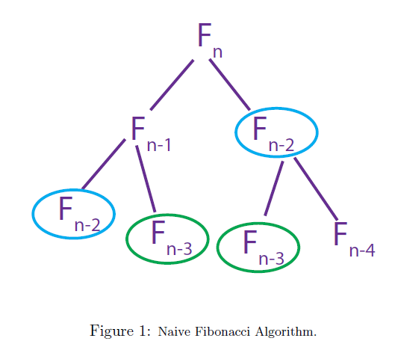
EXPONENTIAL — BAD!

Slide 5
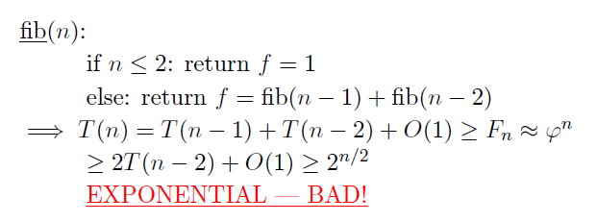
Recursive Definition of the Fibonacci Numbers
T(n) = T(n − 1) + T(n − 2) + O(1)

Slide 6
Dynamic Programming
Dynamic programming like the divide and conquer method, solves problem by combining the solutions of sub problems
Divide and conquer method
partition the problem into independent sub problems
solves the sub problems recursively
combine their solutions to solve the original problem

Slide 7
Dynamic Programming
Dynamic programming is applicable,
when the sub-problems are NOT independent, that is when sub-problems share sub sub-problems.
It is making a set of choices to arrive at optimal solution.
If sub-problems are not independent,
we have to further divide the problem.
In worst case,
we may end-up with an exponential time algorithm.

Slide 8
Dynamic Programming
Divide & Conquer
It involves the sequence of four steps:
1. Characterize the structure of an optimal solution.
2. Recursively define the value of an optimal solution.
3. Compute the value of an optimal solution bottom-up.
4. Construct an optimal solution from computed information
It deals (involves) three steps at each level of recursion: Divide the problem into a number of subproblems. Conquer the subproblems by solving them recursively. Combine the solution to the subproblems into the solution for original subproblems.

Slide 9
Dynamic Programming
Divide & Conquer
It is non Recursive.
It solves subproblems only once and then stores in the table.
It is a Bottom-up approach.
In this subproblems are interdependent.
For example: Matrix Multiplication.
It is Recursive.
It does more work on subproblems and hence has more time consumption.
It is a top-down approach.
In this subproblems are independent of each other.
For example: Merge Sort & Binary Search etc

Slide 10
Dynamic Programming
Frequently, there is a polynomial number of sub-problems, but they get repeated.
A dynamic programming algorithm solves every sub-problem just once and then saves its answer in a table, thereby avoiding the work of re-computing the answer every time the sub-problem is encountered
So we end up having a polynomial time algorithm.
Which is better, Dynamic Programming or Divide & conquer?

Slide 11
Optimization Problems
Dynamic problem is typically applied to Optimization Problems
In optimization problems there can be many possible solutions. Each solution has a value and the task is to find the solution with the optimal ( Maximum or Minimum) value. There can be several such solutions.

Slide 12
4 steps of Dynamic Programming Algorithm
1. Characterize the structure of an optimal solution.
2. Recursively define the value of an optimal solution.
3. Compute the value of an optimal solution bottom-up.
4. Construct an optimal solution from computed information
Often only the value of the optimal solution is required so step-4 is not necessary.
If we need only the value of an optimal solution, and not the solution itself, then we can omit step 4.

Slide 13
Recursive Algorithm (seen earlier)
Takes Exponential time, seen few lectures back!
Actual sub problems are polynomial (O(n)) but they get repeated
Sub problems are not INDEPENDENT.
Sub problems share sub-sub problems.
We can solve it using Dynamic programming.

Slide 14
Memoized DP Algorithm
Remember, remember
memo = { }
fib(n): if n in memo: return memo[n]
else: if n ≤ 2 : f = 1
else: f = fib(n − 1) + fib(n − 2)
memo[n] = f
return f

Slide 15
Benefit of Dynamic Programming
// to compute fibonacci(n)
int[] d = new int[n+1];
for (int j = 2; j<=n; j++)
d[j] = -1;
d[0] = 1;
d[1] = 1;
int fibonacci(int n)
{
if (d[n-1] < 0)
d[n-1] = fibonacci(n-1);
d[n] = d[n-1] + d[n-2];
return (d[n]);
}

Slide 16
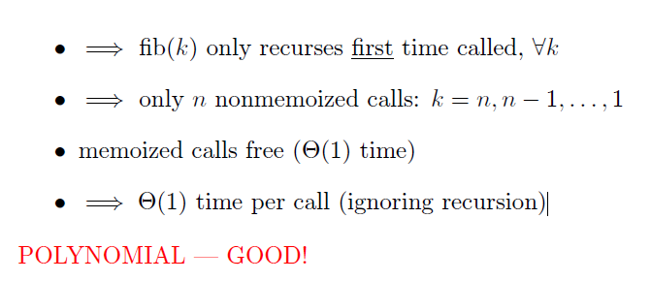
Memoized DP Algorithm

Slide 17
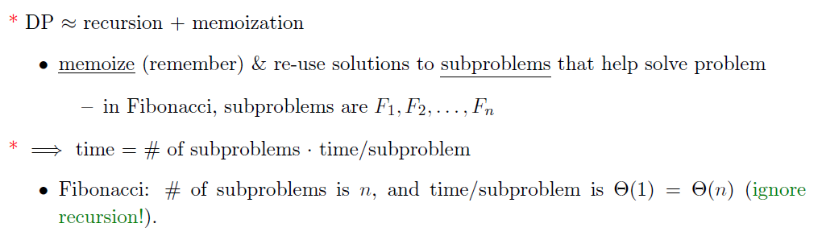
Memoized DP Algorithm

Slide 18
Memoization
A variation of Dynamic Programming and is TOP-DOWN
Memoize the natural, but inefficient, recursive algorithm.
Maintains an entry in the table for the solution to each sub-problem.
Offers efficiency while maintaining top-down strategy.

Slide 19
Memoization
A special character stored at each empty solution space.
When the sub-problem is first encountered, it’s solution is computed and stored.
Each subsequent time the sub-problem is encountered, its solution is looked up.
Time to search the sub-problem solutions?

Slide 20
Bottom-up DP Algorithm
fib = { }
for k in [1, 2, . . . , n]:
if k ≤ 2: f = 1
else: f = fib[k − 1] + fib[k − 2]
fib[k] = f
return fib[n]
Θ(n)
Θ(1)

Slide 21
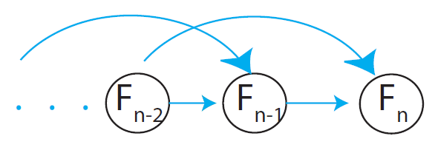
Bottom-up DP Algorithm
exactly the same computation as memoized DP (recursion “unrolled”)
practically faster: no recursion
analysis more obvious
can save space: just remember last 2 fibs =⇒ Θ(1)

Slide 22
Benefit of Dynamic Programming
// to compute fibonacci(n)
int[] d = new int[n+1];
for (int j = 2; j<=n; j++)
d[j] = -1;
d[0] = 1;
d[1] = 1;
int fibonacci(int n)
{
if (d[n-1] < 0)
d[n-1] = fibonacci(n-1);
d[n] = d[n-1] + d[n-2];
return (d[n];
}
// to compute fibonacci(n)
int[] d = new int[n+1];
for (int j = 2; j<=n; j++)
d[j] = -1;
d[0] = 1;
d[1] = 1;
int fibonacci(int n)
{
for(int j = 2; j<= n; j++)
d[j] = d[j-1]+d[j-2];
return (d[n]);
}

Slide 23

Dynamic-programming hallmark #1
Optimal substructure
An optimal solution to a problem (instance) contains optimal solutions to subproblems.
L15.16

Slide 24
Dynamic-programming hallmark #2
Overlapping subproblems
A recursive solution contains a “small” number of distinct subproblems repeated many times.
L15.23

Slide 25
Rod Cutting Problem using Dynamic Programming

Slide 26
Rod Cutting
Example: rod cutting
We are given prices p_{i} and rods of length i:
length i 1 2 3 4 5 6 7 8 9 10
price p_{i}
1 5 8 9 10 17 17 20 24 30
Question: We are given a rod of length n, and want to maximize
revenue, by cutting up the rod into pieces and selling each of the pieces.
Example: we are given a 4 inches rod. Best solution to cut up? We’ll first
list the solutions:

Slide 27

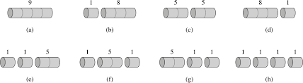
Rod Cutting
We’ll first list the solutions:
1.) Cut into 2 pieces of length 2:
2.) Cut into 4 pieces of length 1:
3-4.) Cut into 2 pieces of length 1 and 3 (3 and 1):
5.) Keep length 4:
6-8.) Cut into 3 pieces, length 1, 1 and 2 (and all the different orders)
Total: 8 cases for n = 4 (= 2^{n-1}). We can slightly reduce by always requiring cuts in non-decreasing order. But still a lot!
length i 1 2 3 4 5 6 7 8 9 10
price p_{i}
1 5 8 9 10 17 17 20 24 30

Slide 28
Rod Cutting
Note: We’ve computed a brute force solution; all possibilities for this simple small example. But we want more optimal solution!
One solution:
recurse on further
i
n-i
What are we doing?
- Cut rod into length i and n-i
Only remainder n-i can be further cut (recursed)
We need to define:
a.) Maximum revenue for log of size n: r_{n} (that is the solution we want to find).
b.) Revenue (price) for single log of length i: p_{i}

Slide 29
Rod Cutting
Example: If we cut log into length i and n-i:
recurse on further
i
n-i
Revenue: p_{i} + r_{n-i}
Can be seen by recursing on n-i
What are we going to do?
There are many possible choices of i:

Slide 30
Rod Cutting
Recursive (top-down) pseudo code:
Problem? Slow runtime (it’s essential brute force)!
But why? Cut-rod calls itself repeatedly with the same parameter values (tree):
- Node label: size of the subproblem
called on
- many subproblems are called repeatedly
(subproblem overlap)
- Number of nodes exponential in n
(2^{n}). therefore exponential number
of calls.

Slide 31
Rod Cutting
Therefore … Dynamic Programing Approach:
Recursive solution is inefficient, since it repeatedly calculates a solution of the same subproblem (overlapping subproblem).
Instead, solve each subproblem only once AND save its solution. Next time we encounter the subproblem look it up in a hashtable or an array (Memoization, recursive top-down solution).
We will also talk about a second solution where we save the solution of subproblems of increasing size (i.e. in order) in an array. Each time we will fall back on solutions that we obtained in previous steps and stored in an array (bottom-up solution).

Slide 32
Rod Cutting
Recursive top-down solution: Cut-Rod with Memoization
Step 1 Initialization:
Creates array for holding memoized
results, and initialized to minus infinity.
Then calls the main auxiliary function.

Slide 33
Rod Cutting
Step 2: The main auxiliary function, which goes through the lengths, computes answers to subproblems and memoizes if subproblem not yet encountered:

Slide 34
Rod Cutting
Bottom-up solution: Bottom Up Cut-Rod
Each time we use previous values form arrays:
Check if value already known or memoized
v
Compute maximum revenue
if it hasn’t already been
computed.
v
Saving value

Slide 35
Rod Cutting
Run time: For bottom-up and top-down approach O(n²)
Why (double nested loop)?
We can also view the subproblems encountered in graph form.
We reduce the previous tree that included all the subproblems repeatedly
each vertex represents
subproblem of a given size
Vertex label: subproblem size
Edges from x to y: We need
a solution for subproblem x when solving subproblem y

Slide 36
Rod Cutting
Run time: Can be seen as number of edges O(n²)
Note: Run time is a combination of number of items
in table (n) and work per item (n).
The work per item because of the max operation
(needed even if the table is filled
And we just take values from the table)
is proportional to n as in the number of edges
in graph.

Slide 37
Reference
Introduction to Algorithms
15.1 (Rod Cutting)
Chapter # 15
Thomas H. Cormen

